Slide 1
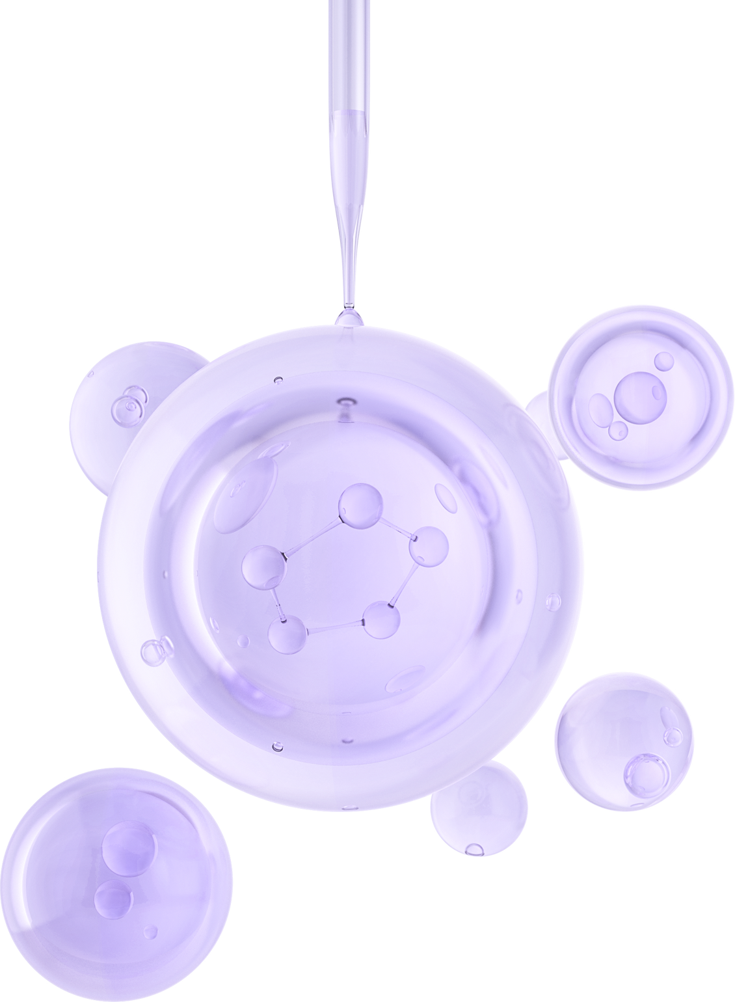

Swiss coding academy
OCTOBER 2025
Final Project
Stroke Data
Presented by Nam Ha Quang

Slide 2
TABLE
of contents
01. Introduction
05. Methodology
02. Objectives
06. Objectives
03. Hypothesis
07. Analysis
04. Goals
08. Contact

Slide 3
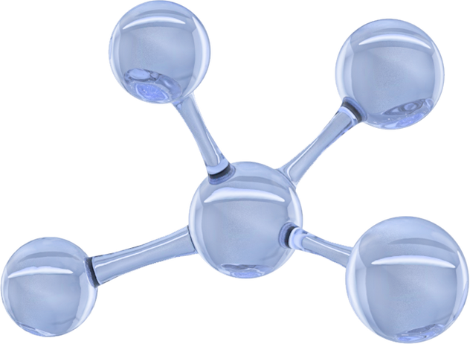

Introduction
Stroke, or cerebrovascular accident, is a major global health problem and one of the leading causes of death and long-term disability.
Key risk factors include hypertension, heart disease, diabetes, smoking, and obesity

Slide 4
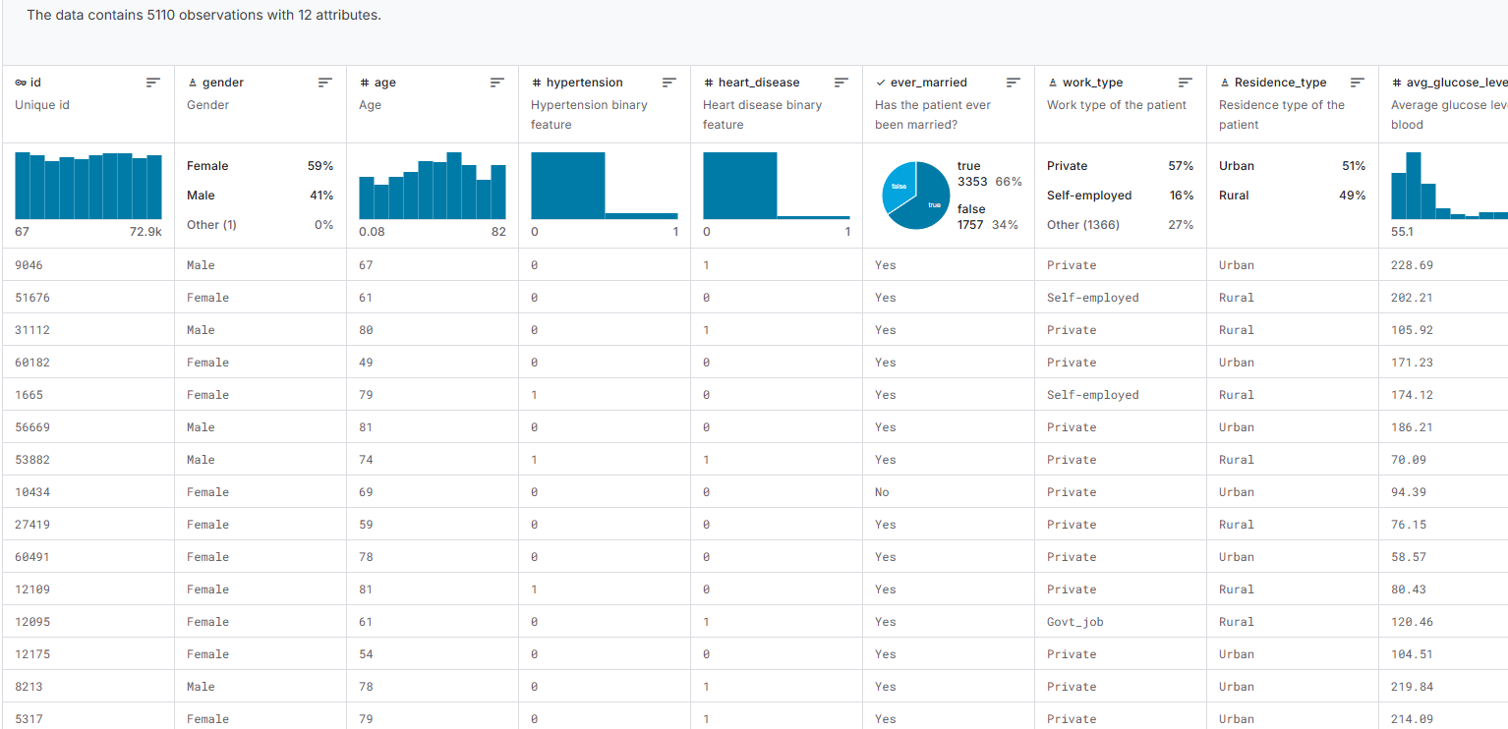
Database
Id: unique identifier
Gender: "Male", "Female" or "Other"
Age: age of the patient
Hypertension: 0 if the patient doesn't have hypertension, 1 if the patient has hypertension
Heart_disease: 0 if the patient doesn't have any heart diseases, 1 if the patient has a heart disease
Ever_married: "No" or "Yes"
Work_type: "children", "Govt_jov", "Never_worked", "Private" or "Self-employed"
Residence_type: "Rural" or "Urban"
Avg_glucose_level: average glucose level in blood
Bmi: body mass index
Smoking_status: "formerly smoked", "never smoked", "smokes" or "Unknown"*
Stroke: 1 if the patient had a stroke or 0 if not

Slide 5
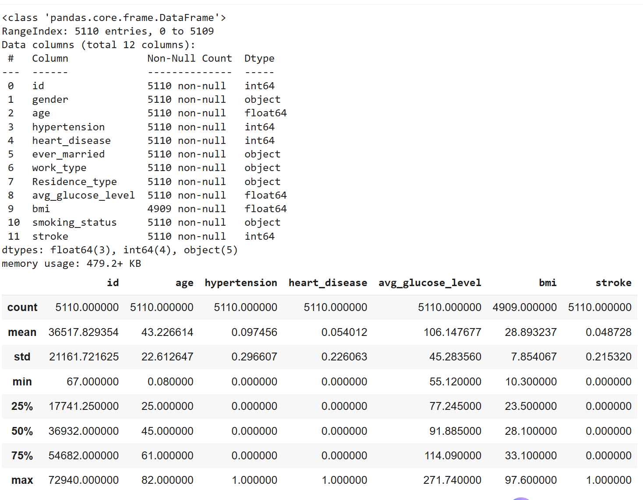
Database
- There are 5110 entries and contains 11 columns
- In database, there are some problems need to solve:
Column to eliminate: Id, ever_married, and work_type
Bmi have 201 null value
In age factor, the min value is 0.08. this is very abnormal

Slide 6
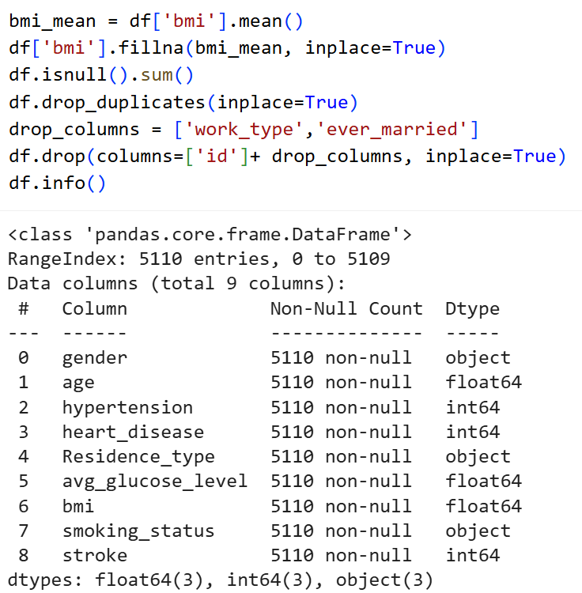
ETL database
Replace null values
Mean value is the value represent for the Bmi values and make the database more accuracy and remain database size
Drop duplicates
There are no duplicates values in the database
Drop unnecessary columns
There are 3 columns have been eliminated: id, work_type, and ever_married

Slide 7
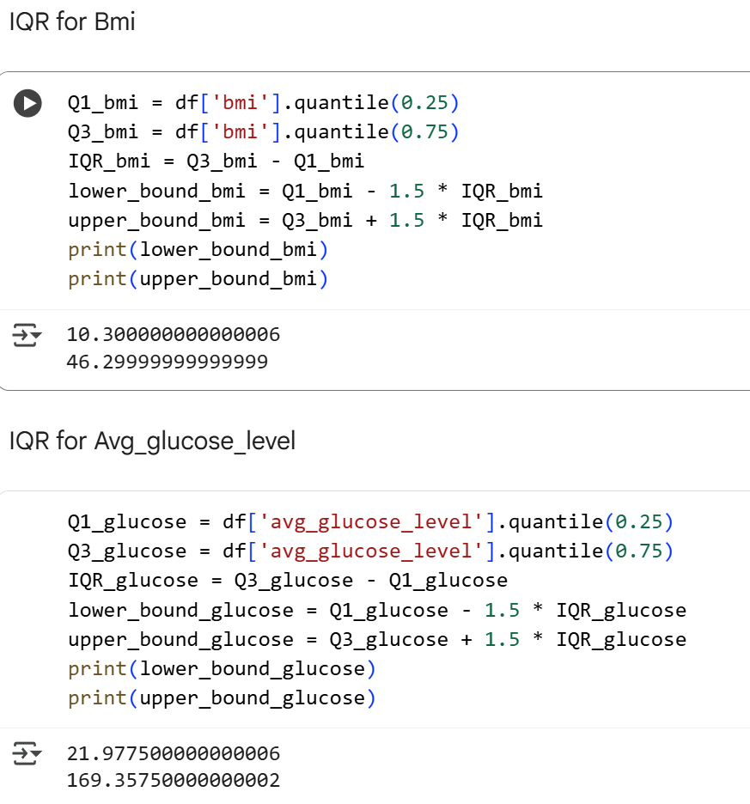
ETL database
IQR for BMI
The lower bound for BMI: 10.3
The upper bound for BMI: 46.3
IQR for Avg_glucose_level
The lower bound for Glucose: 21.98
The upper bound for BMI: 169.36
Can not eliminate the value outside the IQR because the outliers values are the actual values and have the meaning in the database

Slide 8
Group database
Age
Glucose
Hypertension and heart disease
Young: 0 – 16 years old
Teenagers: 17 – 24 years old
Adult: 25 – 64 years old
Old: 64+ years old
Underweight: 0 – 70
Normal: 70 – 100
Overweight: 100 – 126
Obese: > 126
1: Having heart disease and hypertension
0: Doesn’t have.
Heart disease
Hypertension
Age
Glucose
BMI
Smoke
BMI
Smoking group
Underweight: 0 – 18.5
Normal: 18.5 – 21.9
Overweight: 21.9 – 29.9
Obese: > 29.9
Smoking: Smoked and formerly smoked
Non_smoke: Never smoking
Unknown

Slide 9
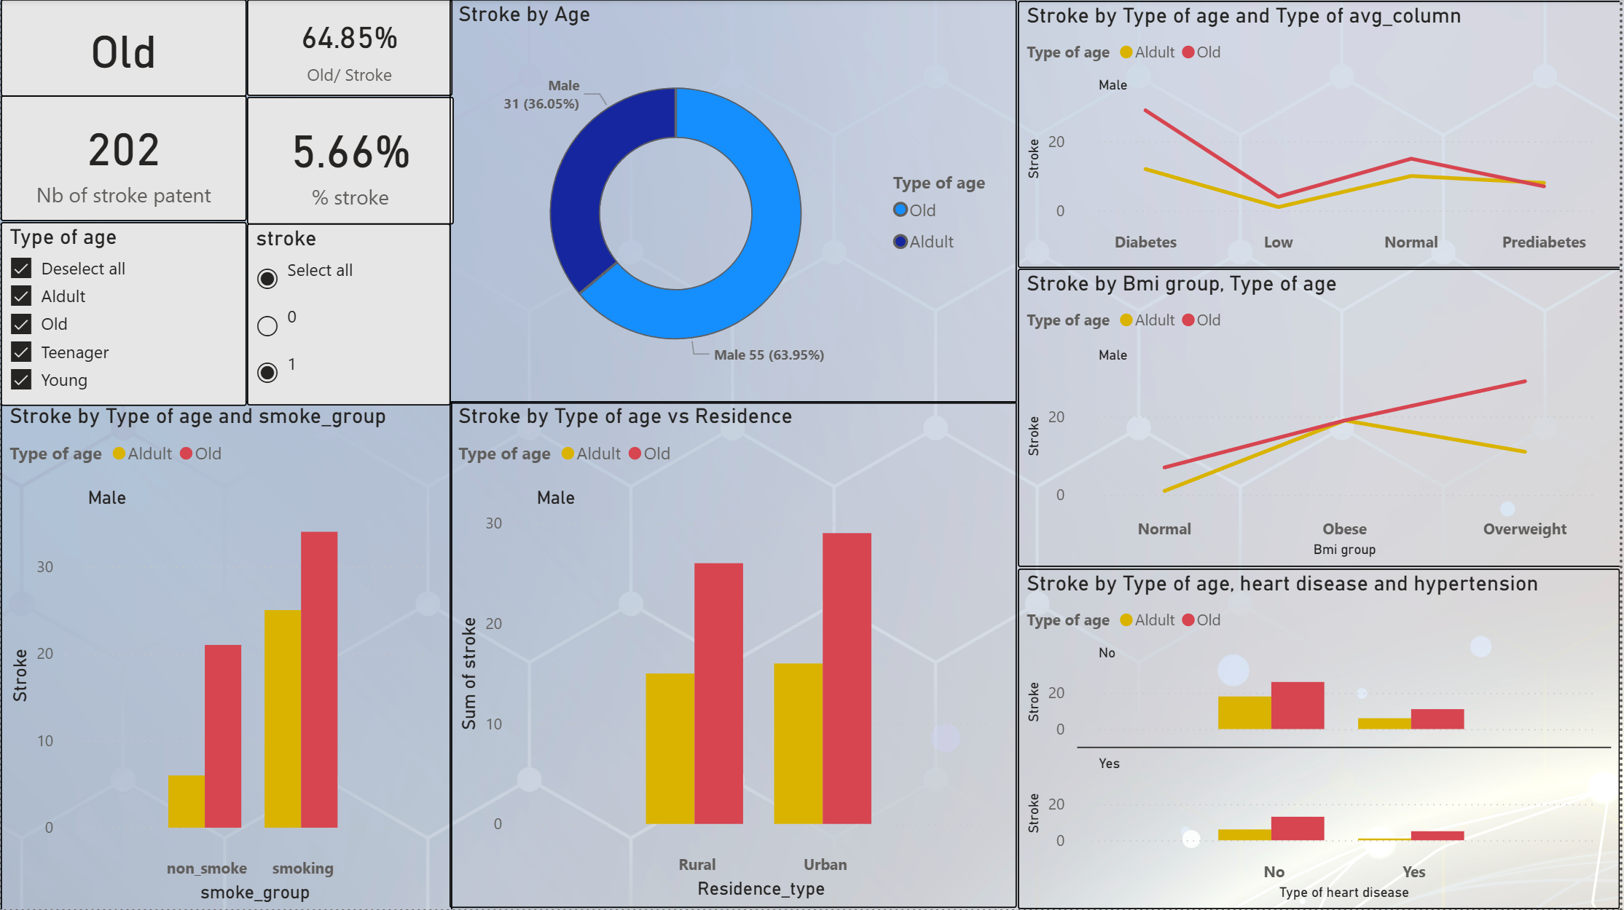
Age
Old is highest group have stroke male patent
Stroke usually appear in adult and old
Old make up 64.85% In stroke patents

Slide 10
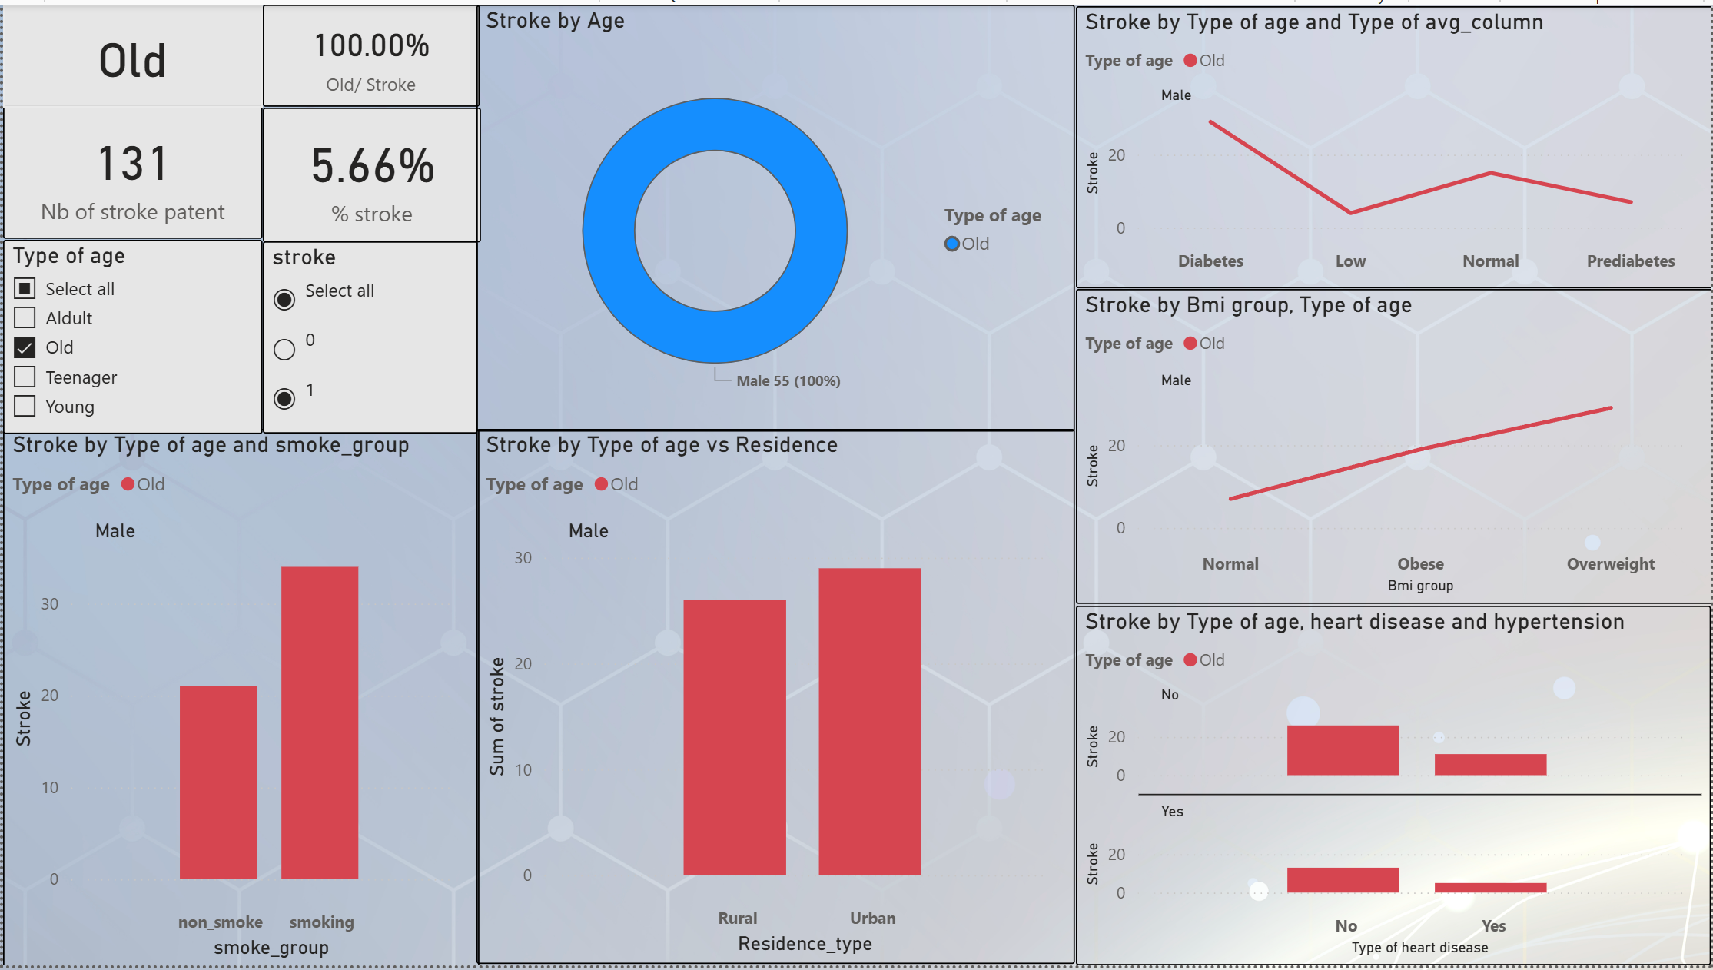
Age
Most of elder men have distributed in Diabetes, Overweight, Urban and smoking
There are 131 old stroke patients
Hypertension and heart disease may not affect to stroke

Slide 11
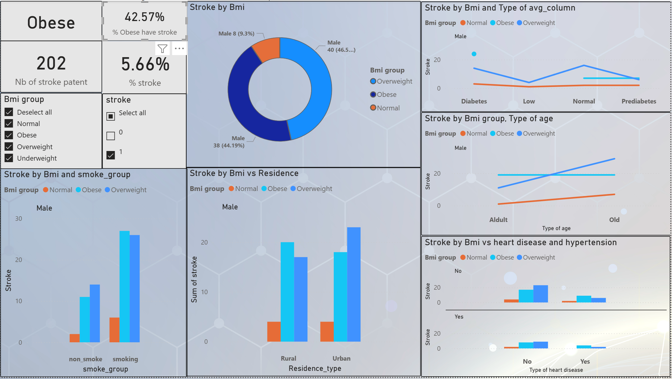
BMI
Overweight BMI contains 42.57% of stroke male patents.
While in Total number of individuals in the database, Overweight BMI represent nearly 47%
Among all patients, those without hypertension and heart disease have the highest proportion of overweight individuals based on their BMI

Slide 12
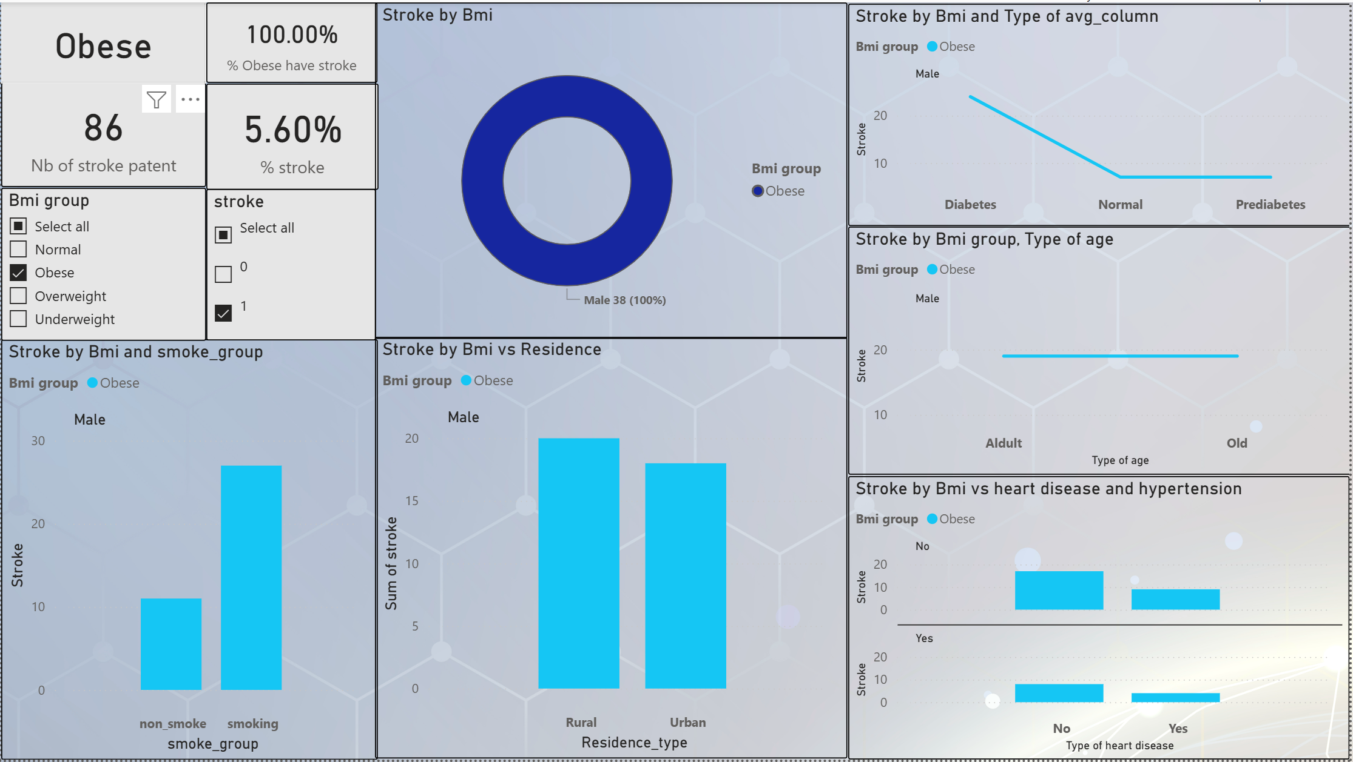
BMI
Difference from age, The highest BMI is Obese have the highest in Rural residence.
Smoking and Diabetes have the highest Obese patients
86 Obese patients have stroke

Slide 13
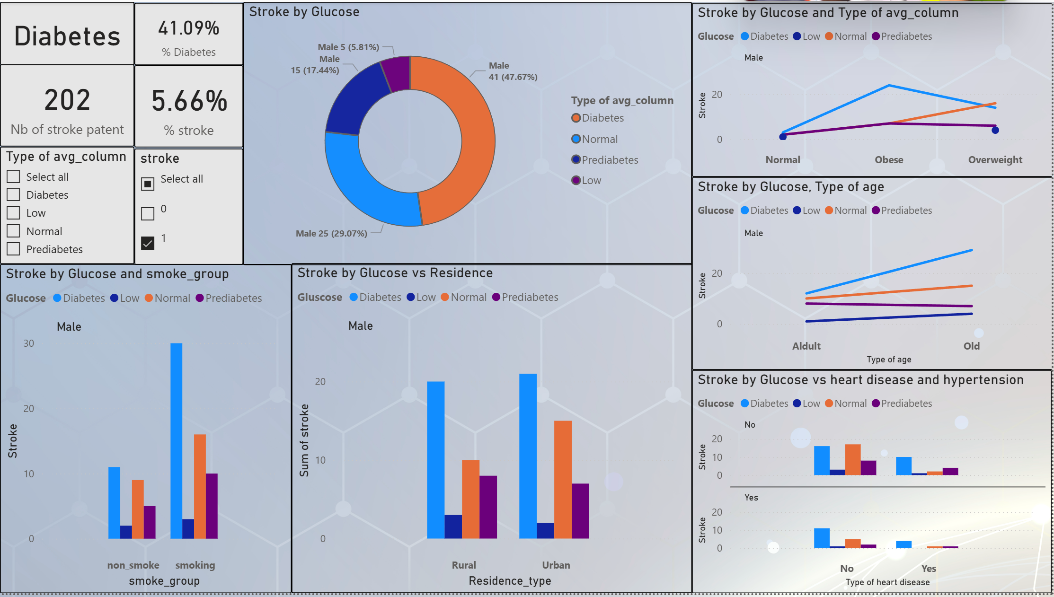
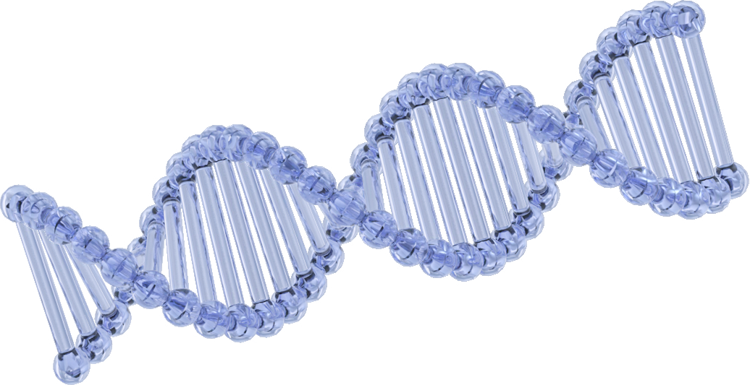
Glucose
Diabetes contains 41.09% of stroke male patients
While Diabetes make up 47.67% in total number in database

Slide 14
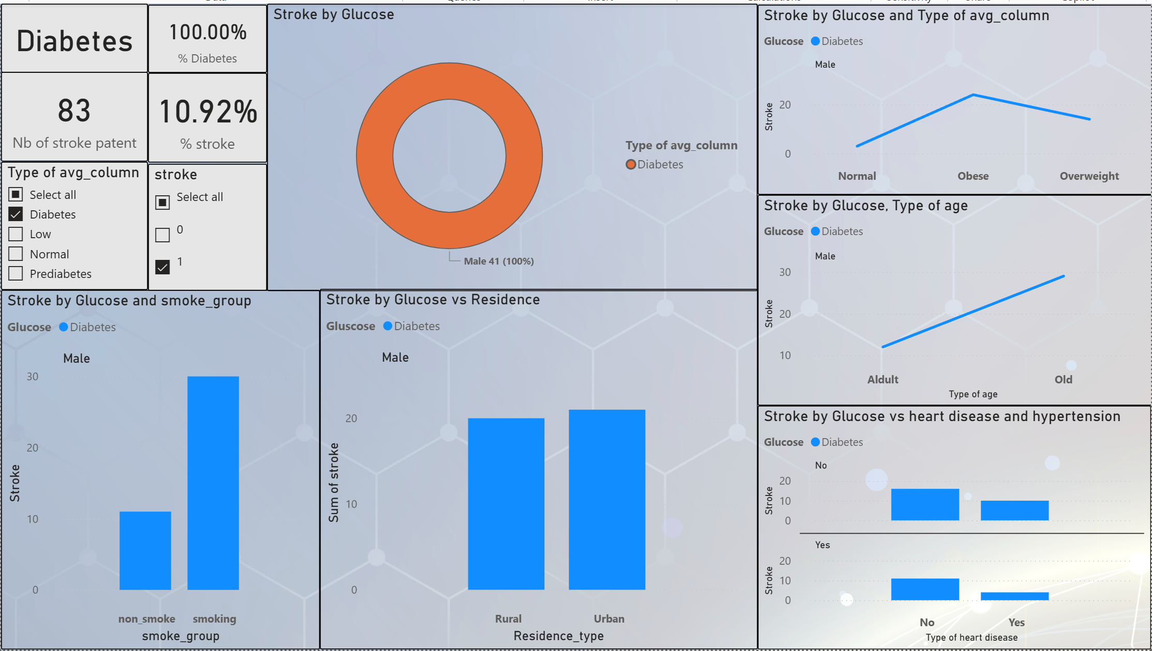
Glucose
Like other categories like old or obese, diabetes have the most distributions in smoke group, glucose and age.
Only in Residence, Obese patients have same numbers in Rural and Urban
There are 83 stroke patients have Diabetes

Slide 15
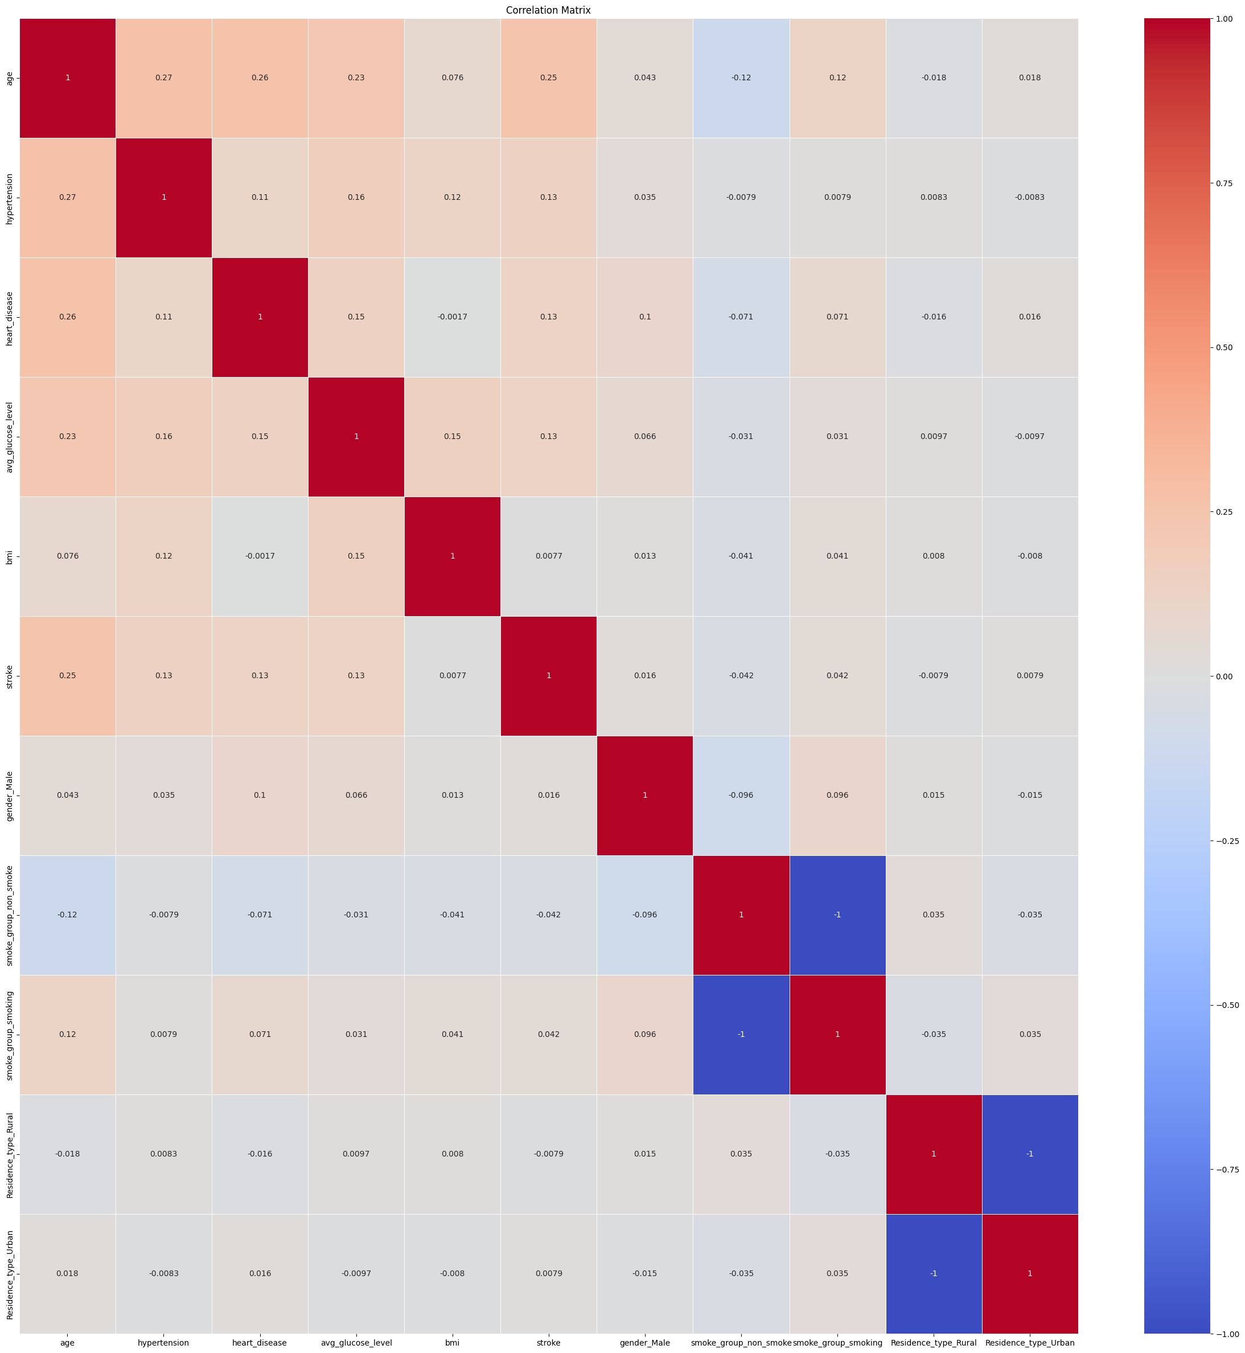
The correlation of database show that more patients have hypertension, heart disease, avg_glucose, bmi and grow up day by day will lead to be stroke .

Slide 16
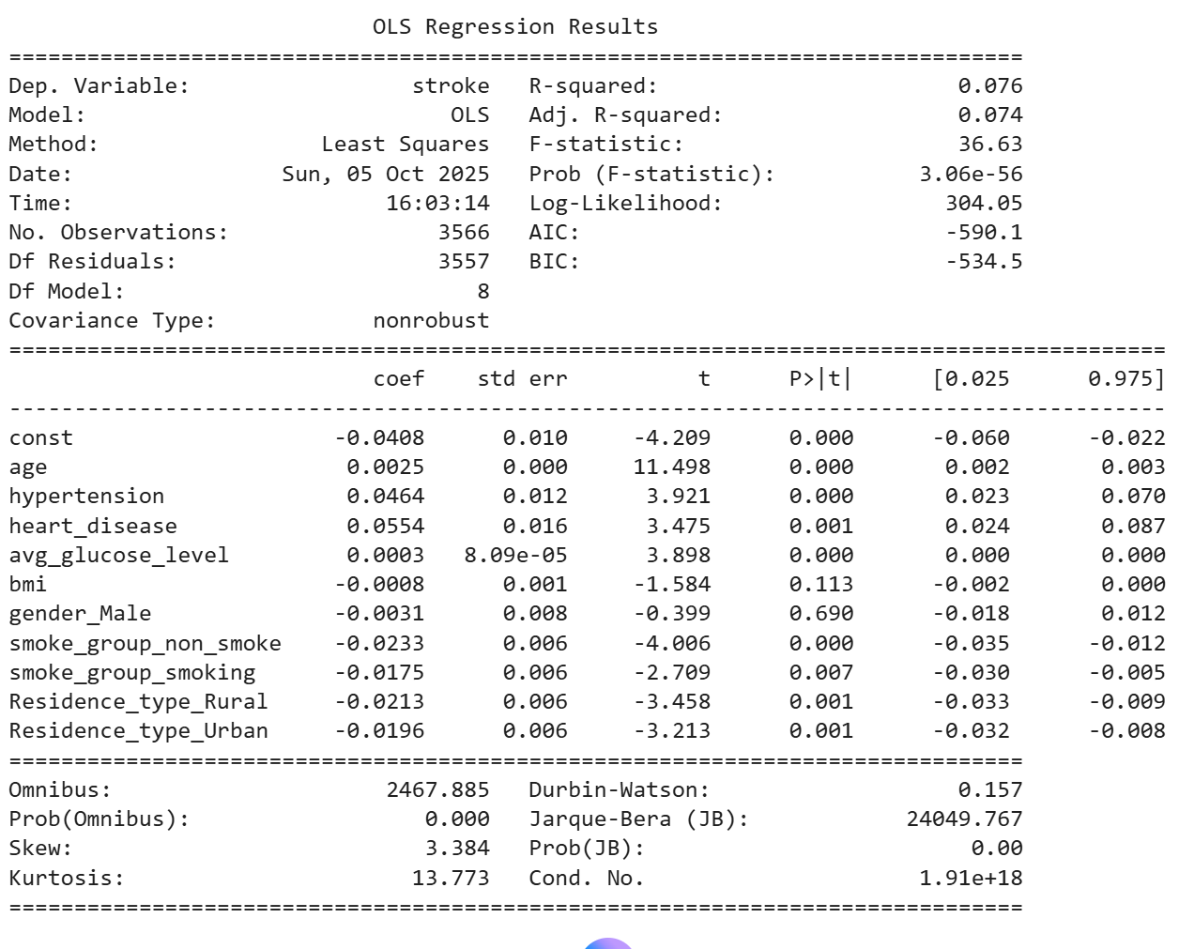

Regression model
Initial database, the p-value of bmi and gender male is over than 0.05 => Need to eliminate.
The R-Square is very weak and the model explains a very small proportion of the variance in the dependent variable

Slide 17
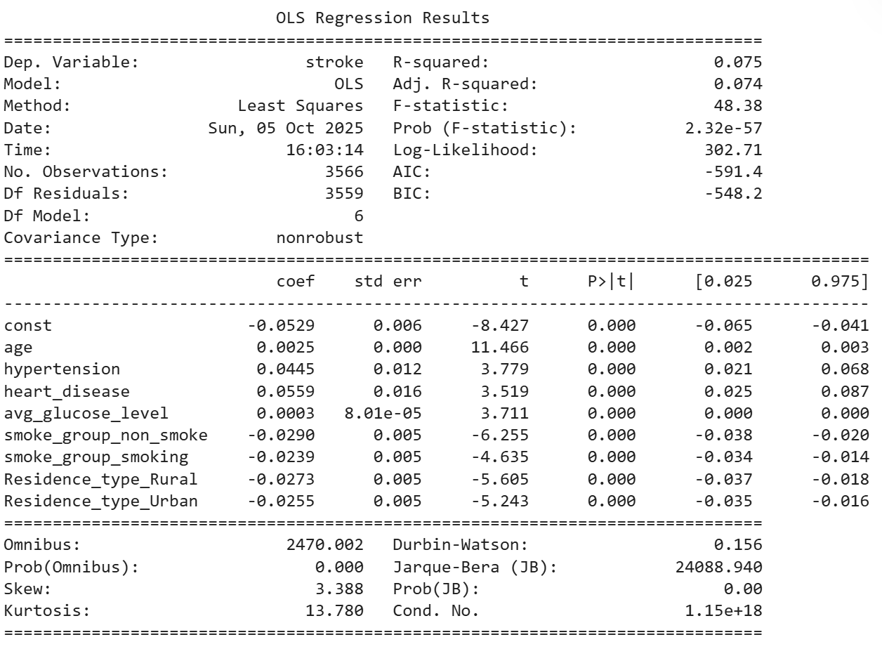
Regression model
The formula of stroke:
Stroke = -0.0529 + 0.0025*age + 0.0445*hypertension + 0.0559*heart_disease +0.0003*avg_glucose_level - 0.0290*non_smoke - 0.0239*smoking - 0.0272*Rural - 0.0255*Urban
The R-Square is very weak and the model explains a very small proportion of the variance in the dependent variable

Slide 18
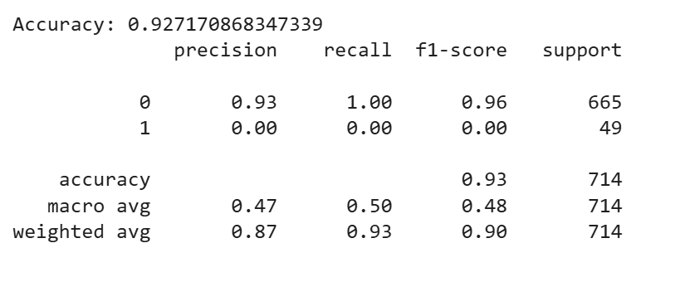
Imbalance database

Slide 19
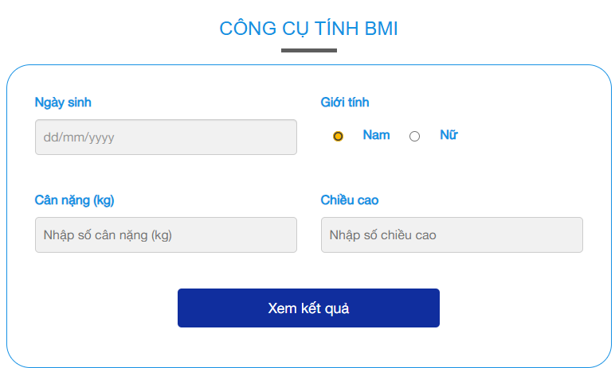
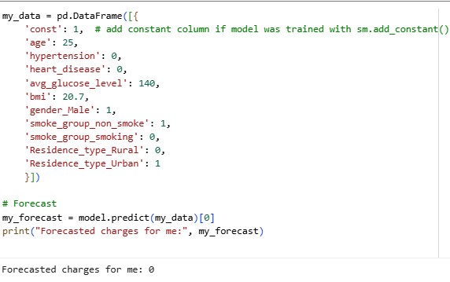
Forecast
BMI calculation
https://tamanhhospital.vn/cong-cu/tinh-bmi-online/

Slide 20
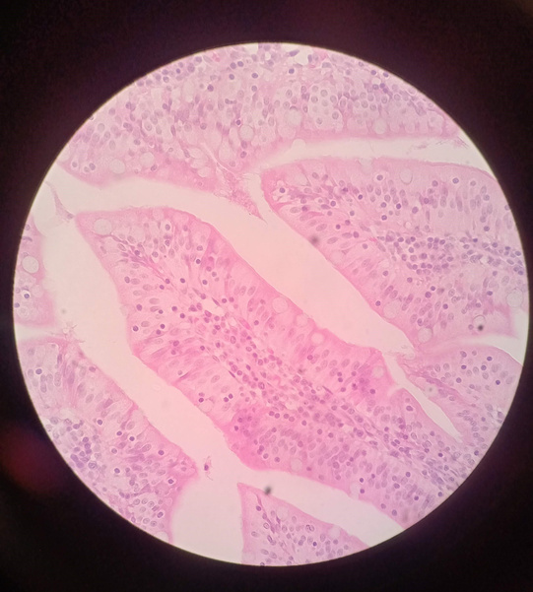
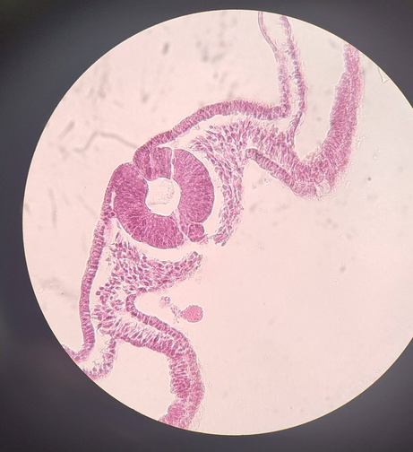
Summarize
EDA
Database
Purpose
Old, Diabetes and Obese are the most proportion of stroke patients
More older, more gain glucose and fat more lead to stroke
The Databe have the accuracy nearly 93% however the database is not balance => Apply SMOTE or cost-sensitive learning
Consider adding time-series data (longitudinal health monitoring) for improved accuracy
Help doctor can predict somebody can be stroke or not base on age, bmi, glucose_level, heart disease and hypertension.

